Slide 1
Flow Chart
Eng/Mostafa Saqly

Slide 2


Why Flowchart
Data-Base

Slide 3
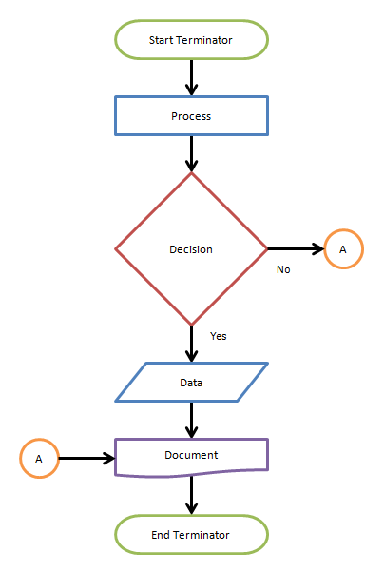
Flowchart
flowchart is a graphical representations of steps.

Slide 4
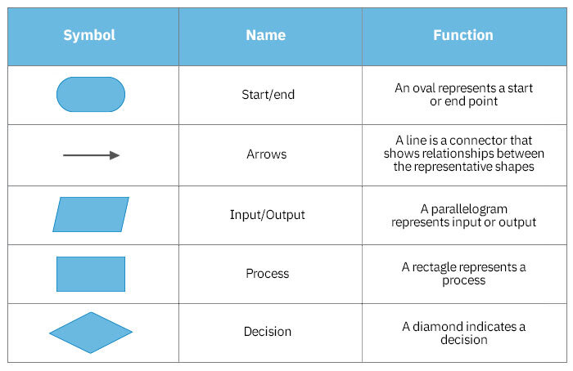
Flowchart Symbols

Slide 5
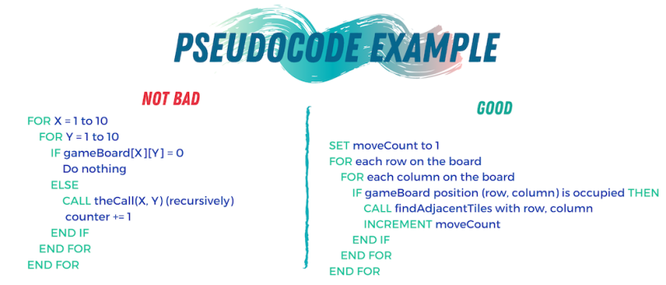

Pseudocode

Slide 6
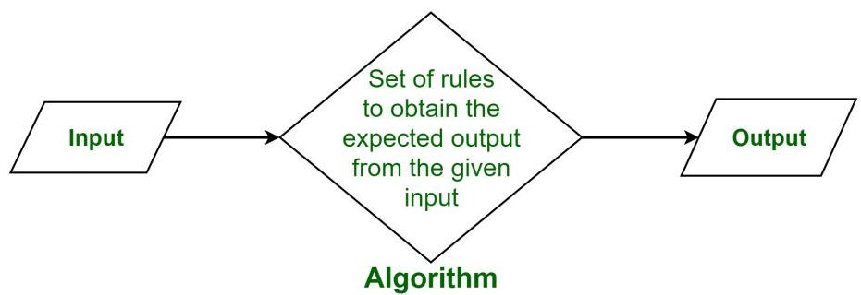
Algorithm

